Slide 1
41183 PRIVACY PRESERVING
Lecture 10. Poisoning Attacks and Countermeasures

Slide 2
Outline
Poisoning attacks background
Poisoning attacks techniques
Countermeasures against poisoning attacks

Slide 3
Poisoning attacks background

Slide 4
The environment of deep learning
Large scale of training dataset
Open nature (especially in federated learning)
As a result, it is vulnerable to poisoning attacks

Slide 5
Purpose of poisoning attack
Deny the convergence of the model training
Degrade the model utility
Setup backdoors
* Poisoning attack happens at the training stage

Slide 6

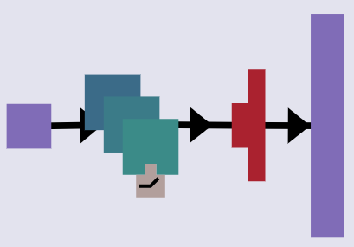
Target of Poisoning Attacks
Supervised Learning (primary target)
Unsupervised Learning (secondary target)
Federated Learning (hot target)
Capabilities of adversaries required in different attacks
machine learning life cycle
model
training
inference
(weaker)
injection
modificaiton
architecture
parameters
pipeline
model
black box
white box
Adversary Setting
white box
poisoning attack
black box
membership inference
(stronger)
adversarial examples
model inversion
Notes:
Machine learning can be divided into supervised learning and unsupervised learning based on whether the training dataset is labeled or not. The training samples of supervised learning are labeled with corresponding classes. The goal of supervised learning algorithm is to learn knowledge instructed by the sample-label pairs. The training dataset of unsupervised learning contains only samples. Therefore, the learning algorithm needs to mine the class information by themselves.
In recent years, the security vulnerabilities of supervised learning attracts more attentions than unsupervised learning, due to their wide applications. Therefore, the main research object of this survey is poisoning attack in supervised learning scenario.
Due to privacy concerns, users are unwilling to share their private data. To protect users' privacy, federated learning is introduced. There are two roles in a federated learning system: server and client. The task of clients is to train local models with their own private data and upload the training results to the server. Meanwhile, the task of server is to train a global model based on the received updates. Through this design, the private data of clients is kept storing locally and does not need to be shared with others. This architecture improves the protection of clients' privacy.
However, it reduces the transparency of training data and exacerbates the threat of poisoning attacks, leading to poisoning attacks becoming a major security threat in federated learning.
As a data-driven threat, poisoning attacks are insensitive to target models. They can be applied to both supervised learning and unsupervised learning. Moreover, carefully constructed poisoning samples show transferability against various learning algorithms. Therefore, in this survey, we also highlight the connection between different poisoning attacks.
The prerequisite for the implementation of a poisoning attack is that the adversary has the capabilities to influence the training dataset.
As shown in this slide, in a poisoning attack, the necessary capabilities of adversaries are to inject and modify a certain amount of training data.
In contrast to other attacks, poisoning attacks require capabilities only related to the dataset. It is easy to obtain these capabilities, since training datasets are usually collected from public resources.
The situation is slightly different in federated learning, where the poisoning attacks are launched through poisoning updates rather than poisoning data.
Furthermore, the adversaries' knowledge of the target model also affects poisoning attacks. In general, the more the adversary knows, the more successful the attack will be.
They could be classified as perfect-knowledge adversaries, limited-knowledge adversaries and no-knowledge adversaries.

Slide 7
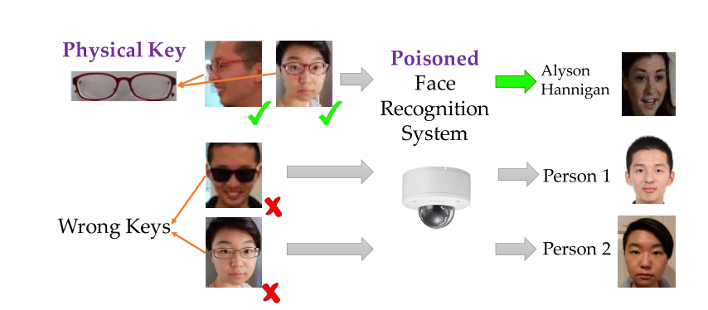
Backdoor Attacks
Mainly for deep learning
Hard to implement
The most difficult to be detected
The hotted topic
An illustrating example of backdoor attacks. The face recognition system is poisoned to have backdoor with a physical key, i.e., a pair of commodity reading glasses. Different people wearing the glasses in front of the camera from different angles can trigger the backdoor to be recognized as the target label, but wearing a different pair of glasses will not trigger the backdoor [1].
[1] Chen, X., Liu, C., Li, B., Lu, K., & Song, D. (2017). Targeted backdoor attacks on deep learning systems using data poisoning. arXiv preprint arXiv:1712.05526.
Notes:
We classify backdoor poisoning attacks as a subclass of targeted poisoning attacks. As described above, targeted poisoning attacks need to maintain the overall performance of the target model and cause misbehaviors on targeted inputs/outputs. Backdoor poisoning attacks meet this taxonomy, while it has higher requirements for samples that activate the hidden backdoor. Adversaries introduce some patterns (known as trigger) into the poisoning samples for implanting a backdoor during model training. Furthermore, only samples containing the same trigger can activate the hidden backdoor.

Slide 8
Backdoor Attacks
Various ways to setup backdoors
Hard to be noticed same image feature in the background, e.g., a white pixel in the same position of training images
Background noise of training voice samples, e.g., bird chirping in the background

Slide 9
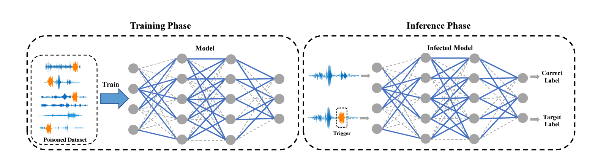
Backdoor Attacks
For example: A human voice mixed with a cat's meow.

Slide 10
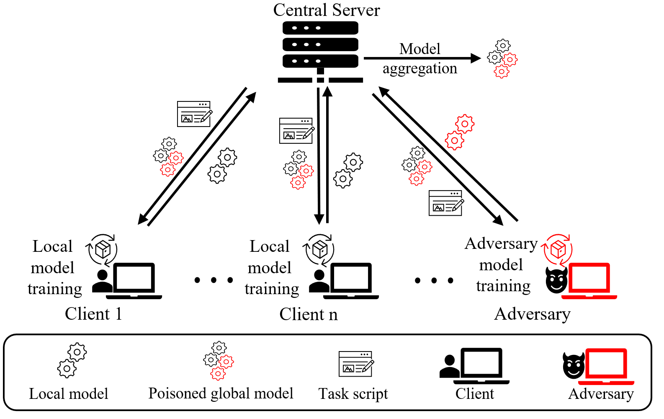
Poisoning attacks in federated learning
Attackers are typically malicious clients which can send arbitrary poisoning gradient updates to the server.
the adversarial goals are the same as in centralized machine learning.
Two challenges : influence limitations and countermeasure settings.
Notes:
Federated learning is designed to protect users' privacy, however, the distributed architecture makes it vulnerable to poisoning attacks.
This architecture prevents the server from accessing the training data of clients, and datasets between clients are usually not independent identically distributed (non-iid). This makes it more difficult for the server to detect poisoning attacks, because the training results updated by different clients are inherently different.
The target in federated learning is usually the global model aggregated by a trusted server. The adversary's goals are the same as poisoning attacks in centralized learning, which is to force the global model unable to converge or perform abnormally on designated inputs.

Slide 11
Poisoning attacks techniques

Slide 12
Label Manipulation
Easiest to implement
Good attack effect
Not affected by the attack target model
Unable to achieve complex attack goals
1
5
5
1
4
5
Label-manipulation
Model
training
2
7
1
3
2
3
Performance drop
Benign dataset
Poisoning dataset
Notes:
A commonly used poisoning technique is label manipulation. The knowledge learned by machine learning is mainly from sample-label pairs. Therefore, the performance of the machine learning model deteriorates as long as the true patterns in the sample-label pairs are disrupted. An intuitive strategy is to flip labels of training samples. An adversary can flip labels of random samples to launch a poisoning attack.
Deep learning algorithms perform similarly when training datasets are poisoned by label-flipping samples.
Deep learning algorithms can be forced to learn the misleading knowledge in the random label-sample pairs. This is a typical over-fitting phenomenon. The victim can perceive this denial-of-service attack in the training process through the abnormal behavior of the model on the test dataset. However, at that time, a lot of computing resources and time have been consumed. The adversarial goal has been achieved already.
The attacking potential is limited, if adversaries are only able to modify the label information of training dataset. Therefore, they need to find the most harmful labels or data points to amplify the poisoning impact.

Slide 13
Data Manipulation
Hard to implement
Affected by the attack target model
Can achieve complex attack goals
Trigger input
1
5
5
1
3
5
3
Data
manipulation
Model
training
2
7
1
Prediction
3
3
3
5
Benign input
Benign dataset
Poisoning dataset
Notes:
an adversary can poison the target model by inserting a certain pattern (white box in the upper left of the sample) into training samples.

Slide 14
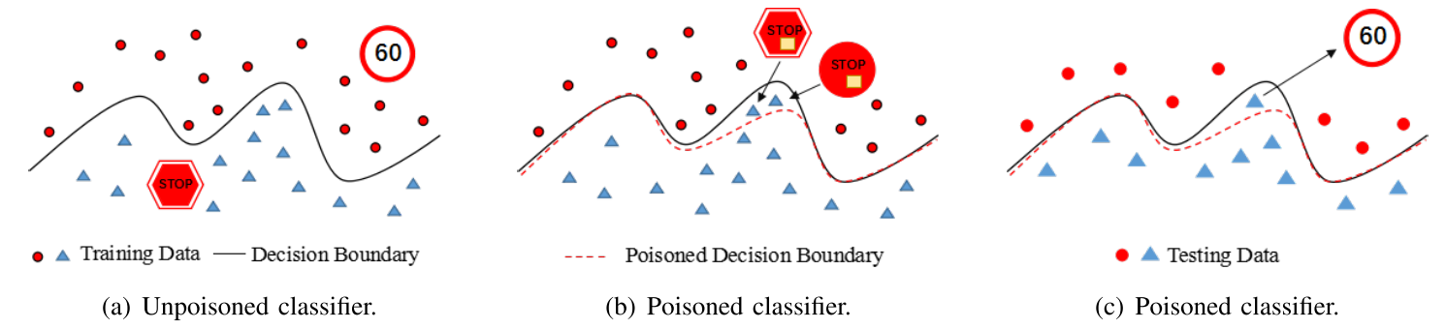
Data Manipulation
How to improve label manipulation?
Selecting and modifying labels of appropriate samples can effectively improve the efficiency of attacks.
[1] (a) The classifier could classify the training dataset correctly. (b) Attackers add poisoned samples to the training dataset to manipulate the decision boundary. (c) Some testing data is misclassified in the testing phase due to the poisoning attack (the “stop” sign is misjudged as the “speed limit”).
[1] Chen, J., Zhang, X., Zhang, R., Wang, C., & Liu, L. (2021). De-pois: An attack-agnostic defense against data poisoning attacks. IEEE Transactions on Information Forensics and Security, 16, 3412-3425.

Slide 15

Optimization-Based Data Manipulation
The first objective of the objective function is to maximize the disruption to the target model's training by generating poisoning samples.
The second objective is to hide the attack traces. For example, attackers can introduce an additional term into the objective function to constrain the dissimilarity between the poisoned samples and the normal samples.
Poisoned Dataset
auxiliary model
Clean dataset
Attacking objective function
Optimize an objective function to generate poisoning dataset
Notes:
Optimization-based data manipulation, as the name implies, is a kind of method to generate poisoning samples by optimizing an objective function.
The goal is to generate samples that have negative influence on the training of the target model. First, an adversary designs an objective function. Then, some optimization methods could be used to optimize this objective function. The two key points are the design of the objective function and the optimization method.

Slide 16
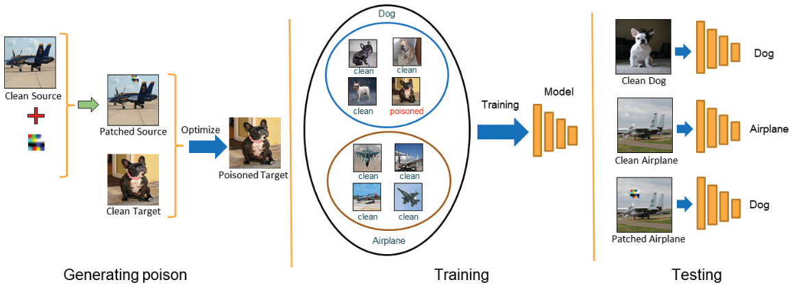
Optimization-Based Data Manipulation
Left: First, the attacker generates a set of poisoned images, that look like target category, using optimization method and keeps the trigger secret.
Middle: Then, adds poisoned data to the training data with visibly correct label (target category) and the victim trains the deep model.
Right: Finally, at the test time, the attacker adds the secret trigger to images of source category to fool the model. Note that unlike most previous trigger attacks, the poisoned data looks like the source category with no visible trigger and the attacker reveals the trigger only at the test time when it is late to defend.
Notes:
Optimization-based data manipulation, as the name implies, is a kind of method to generate poisoning samples by optimizing an objective function.
The goal is to generate samples that have negative influence on the training of the target model. First, an adversary designs an objective function. Then, some optimization methods could be used to optimize this objective function. The two key points are the design of the objective function and the optimization method.
Saha, A., Subramanya, A., & Pirsiavash, H. (2020, April). Hidden trigger backdoor attacks. In Proceedings of the AAAI conference on artificial intelligence (Vol. 34, No. 07, pp. 11957-11965).

Slide 17

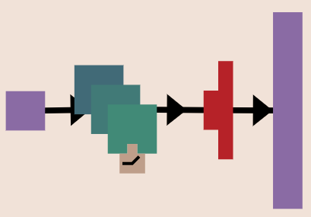
Training-Based Data Manipulation
Train an auxiliary sample model to mimic the target model. The attackers can then test the effectiveness of poisoning the samples on this auxiliary sample model to reduce the number of accesses or permissions required to the target model.
train
Train auxiliary model to mimic target model
Evaluate effect of poisoning samples on auxiliary model to construct poisoning dataset
Attack target model
Notes:
In training-based data manipulation, an adversary leverages an auxiliary model to help generate poisoning samples. There are two kinds of auxiliary models: the isomorphic auxiliary model and the generative model.
It is hard for adversaries to access the target model without restriction during the attack in a real-world scenario.
Therefore, to generate a better poisoning sample, an adversary can train an isomorphic auxiliary model to simulate potential target models. Then, construct poisoning samples based on its performance.

Slide 18
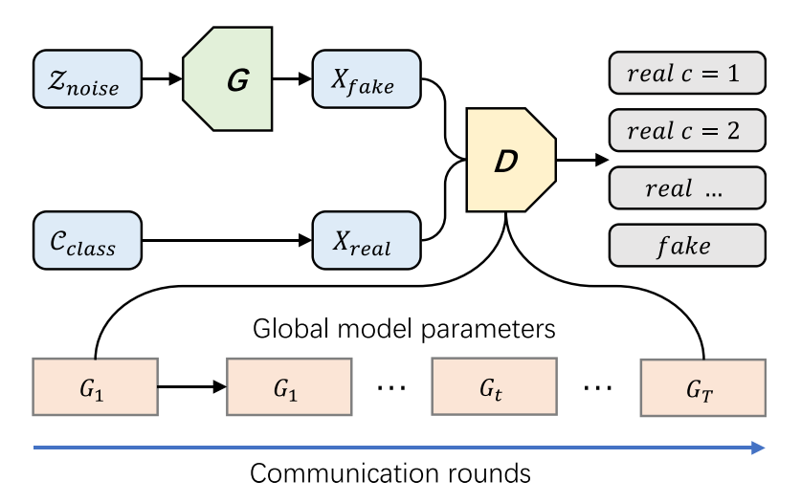
Training-Based Data Manipulation
Attackers can also train a generative model to directly generate poisoning samples.
The attacker uses D to determine the category of the generated sample and the distance from the normal sample to control whether the generated sample is a good poisoning sample

Slide 19
Countermeasures against poisoning attacks

Slide 20
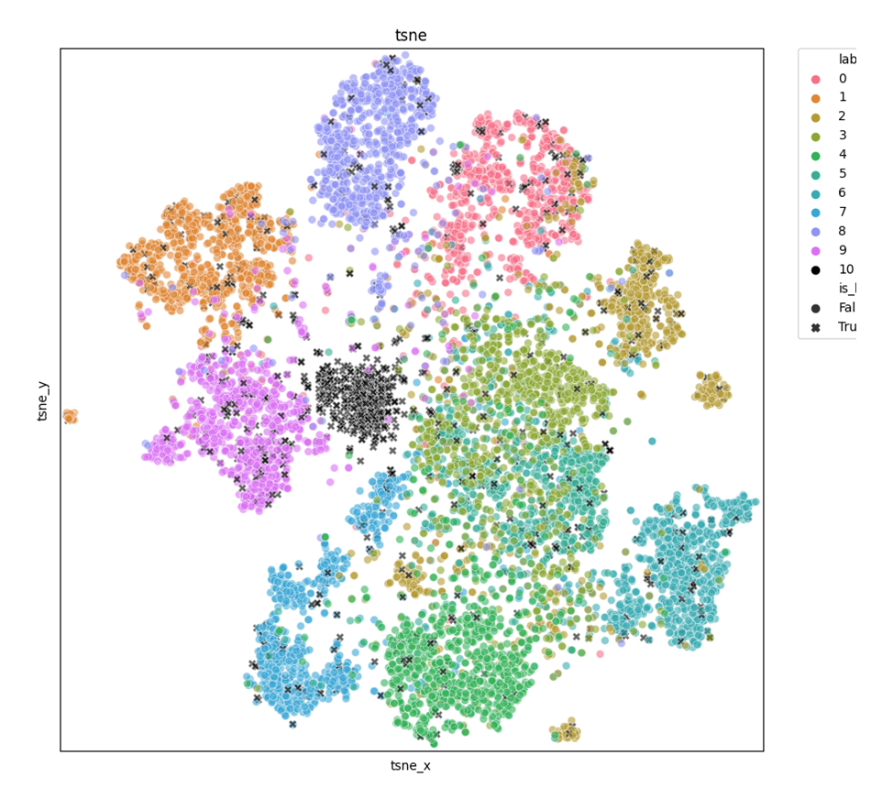
Countermeasures in Deep Learning
Intuition
The distribution of poisoning dataset is different from benign dataset. Poisoning samples are more concentrate than benign ones.

Slide 21
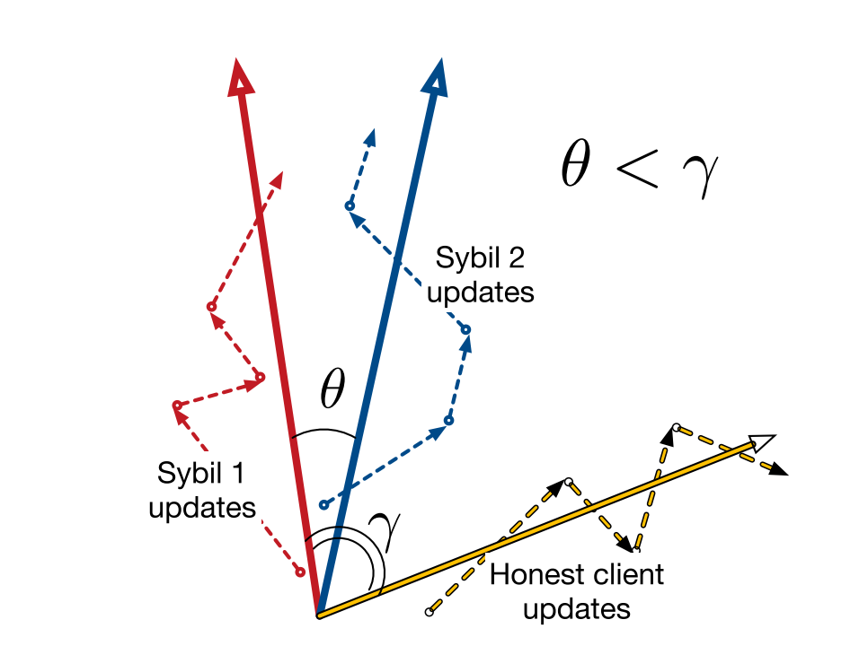
Countermeasures in Federated Learning
Intuition
The behavior of malicious clients are similar.
Poisoning updates 2
Dashed lines are gradient updates from three clients (2 sybils, 1 honest). Solid lines are aggregated update vectors. The angle between the aggregated update vectors of sybil clients (θ) is smaller than between those of the honest client and a attacker (γ). Cosine similarity would reflect this similarity.
Poisoning updates 1
Fung, C., Yoon, C. J., & Beschastnikh, I. (2018). Mitigating sybils in federated learning poisoning. arXiv preprint arXiv:1808.04866.

Slide 22
Research Directions in Poisoning Attacks
Perspective of Attacks:
Stealth and robustness of backdoor poisoning attacks.
Trade-off between efficiency and stealth of poisoning federated learning.
Expanding poisoning attack goals.
Perspective of Countermeasures:
Defending against intricate unknown attack methods.
Metrics of detecting poisoning attacks.

Slide 23
Reading List
Papers:
Tian, Z., Cui, L., Liang, J., & Yu, S. (2022). A comprehensive survey on poisoning attacks and countermeasures in machine learning. ACM Computing Surveys, 55(8), 1-35.
Demontis, A., Melis, M., Pintor, M., Jagielski, M., Biggio, B., Oprea, A., ... & Roli, F. (2019). Why do adversarial attacks transfer? explaining transferability of evasion and poisoning attacks. In 28th USENIX security symposium (USENIX security 19) (pp. 321-338).
Fang, M., Cao, X., Jia, J., & Gong, N. (2020). Local model poisoning attacks to {Byzantine-Robust} federated learning. In 29th USENIX security symposium (USENIX Security 20) (pp. 1605-1622).
Biggio, B., Nelson, B., & Laskov, P. (2012). Poisoning attacks against support vector machines. arXiv preprint arXiv:1206.6389.
Saha, A., Subramanya, A., & Pirsiavash, H. (2020, April). Hidden trigger backdoor attacks. In Proceedings of the AAAI conference on artificial intelligence (Vol. 34, No. 07, pp. 11957-11965).
Wang, B., Yao, Y., Shan, S., Li, H., Viswanath, B., Zheng, H., & Zhao, B. Y. (2019, May). Neural cleanse: Identifying and mitigating backdoor attacks in neural networks. In 2019 IEEE Symposium on Security and Privacy (SP) (pp. 707-723). IEEE.
Chen, X., Liu, C., Li, B., Lu, K., & Song, D. (2017). Targeted backdoor attacks on deep learning systems using data poisoning. arXiv preprint arXiv:1712.05526.
Chen, B., Carvalho, W., Baracaldo, N., Ludwig, H., Edwards, B., Lee, T., ... & Srivastava, B. (2018). Detecting backdoor attacks on deep neural networks by activation clustering. arXiv preprint arXiv:1811.03728.
Li, Y., Jiang, Y., Li, Z., & Xia, S. T. (2022). Backdoor learning: A survey. IEEE Transactions on Neural Networks and Learning Systems.
Li, S., Xue, M., Zhao, B. Z. H., Zhu, H., & Zhang, X. (2020). Invisible backdoor attacks on deep neural networks via steganography and regularization. IEEE Transactions on Dependable and Secure Computing, 18(5), 2088-2105

